Slide 1
Automated Identification of Patients with Advanced Illness
Raj Brar MD, Marsha Meytlis PhD, Jamie Hirsch MD
Department of Information Services
Syosset Hospital – Division of Hospitalist Medicine

Slide 2
Agenda
Definitions
Problem Description
Objective
Methods
Results
Summary and Future Plans

Slide 3
What is Advanced Illness? Definition from Coalition to Transform Advanced Care “When one or more conditions become serious enough that general health and functioning decline, and treatments begin to lose their impact. This is a process that continues to the end of life.”

Slide 4
What is the LACE Score¹? A risk stratification tool designed to predict 30-day mortality and 30-day readmission risk. L – Length of stay A – Acuity of admission C – Co-morbidities E – Emergency room visits
¹ Van Walraven C, Dhalla IA, Bell C, et al. Derivation and validation of an index to predict early death or unplanned readmission after
discharge from hospital to the community. CMAJ 2010;182:551–7. 10.1503/cmaj.091117

Slide 5
Problem Description:
Surveys show that while most patients prefer to die in their home, in reality, most die in the hospital²
Advanced Illness Management programs have been shown to improve care quality, patient/family/caregiver satisfaction, utilization, and spending³
Our Palliative Care/Advanced Illness team uses a daily report of admitted patients and screens for patients with potential advanced illness using a LACE score >= 10
The team felt they were missing admitted patients that could benefit from their care approach
² Bekelman JE, Halpern SD, Blankart CR, et al. Comparison of Site of Death, Health Care Utilization, and Hospital Expenditures for Patients Dying
With Cancer in 7 Developed Countries. JAMA. 2016;315(3):272–283. doi:10.1001/jama.2015.18603
³ Advanced Illness Management Strategies – American Hospital Association
https://www.aha.org/system/files/2018-02/advanced-illness-management-strategies-2012_0.pdf

Slide 6
Objective:
Develop a better way to automate identification of patients with advanced illness using currently available EHR data

Slide 7
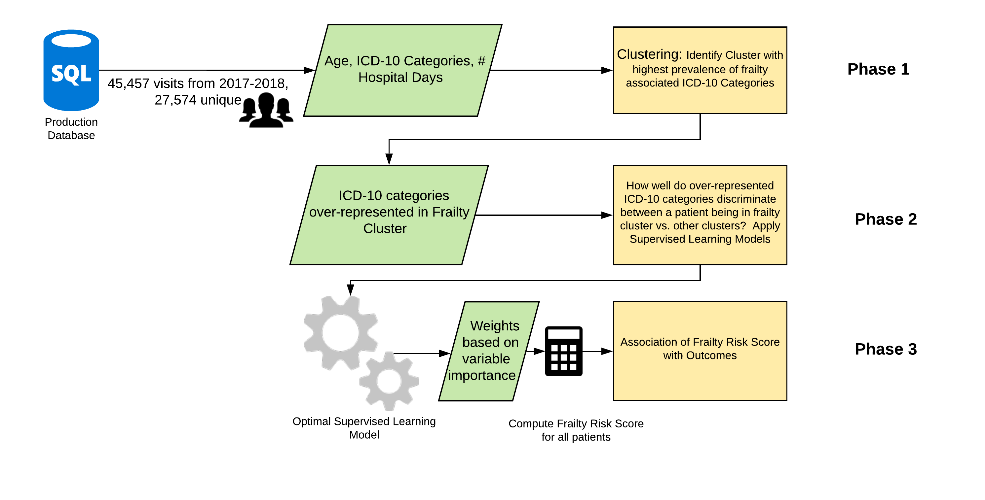
Methods

Slide 8
Phase 1: Clustering
Learn about Advanced Illness in the patient populations at two of our tertiary centers
Identify an Advanced Illness Cluster based on prevalence of frailty associated ICD-10 categories (based on expert opinion)
Identify diagnoses that are over-represented in the Frailty Cluster

Slide 9
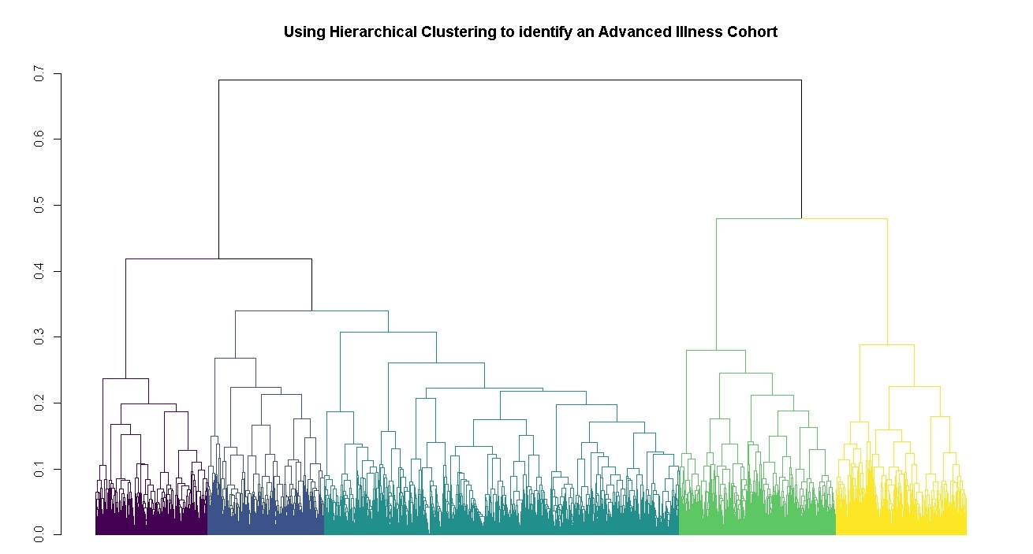
Phase 1: Bottom-up Hierarchical Clustering (stats::hclust())

Slide 10
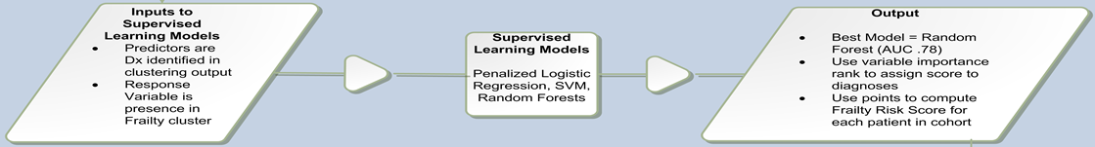
Phase 2: How well do the over-represented ICD-10 categories discriminate between being in the frailty cluster vs. any of the other clusters?
Use the features (over-represented ICD-10 categories in frailty cluster) learned from phase 1 as independent variables
Build a classifier that can discriminate between presence in frail cluster vs. non-frail clusters (R Package: Caret)

Slide 11
Phase 2: How well do the over-represented ICD-10 categories discriminate between being in the frailty cluster vs. any of the other clusters?
Compared 3 algorithms
Currently used LACE score >= 10
Hospital Frailty Risk Score⁴
Modified Hospital Frailty Risk Score
⁴ Gilbert T, Neuburger J, Kraindler J, Keeble E, Smith P, Ariti C, et al. Development and validation of a frailty risk score focusing on older people in acute care
settings using electronic hospital records. Lancet. 2017;391:1775–1782. doi: 10.1016/S0140-6736(18)30668-8

Slide 12
Phase 3
Compare association of best performing Hospital Frailty Risk Score and currently used LACE >= 10 with outcomes (Readmission Risk, Being Seen by Palliative Care Service)

Slide 13
Results

Slide 14
Phase 1: Clustering
Cluster | # Patients | Mean Age | % Female | Mean CCI | Mean # Admits | Mean Hospital Days | Total Admits | % of Patients w/ Frailty Diagnoses | Cluster Theme
1 | 3442 | 82 | 45 | 2.7 | 2 | 9.3 | 5776 | 16.6 | To be determined
2 | 5513 | 84 | 53 | 3.6 | 2 | 14.5 | 10984 | 22.5 | Critical Illness
3 | 4189 | 82 | 65 | 2 | 1 | 7.8 | 5914 | 12.9 | Elective/Low Acuity Surgery Cluster
4 | 10419 | 84 | 59 | 2.5 | 1 | 9.7 | 15565 | 28.8 | To be determined
5 | 4011 | 85 | 65 | 3.2 | 2 | 13 | 7218 | 58.1 | Frailty/Advanced Illness

Slide 15
Phase 2: How well do the over-represented ICD-10 categories discriminate between being in the frailty cluster vs. any of the other clusters?
Which model was able to best identify patients belonging to the Frailty Cluster? - LACE >= 10 – AUC .60 - HFRS – AUC .76 - Modified-HFRS – AUC .78

Slide 16
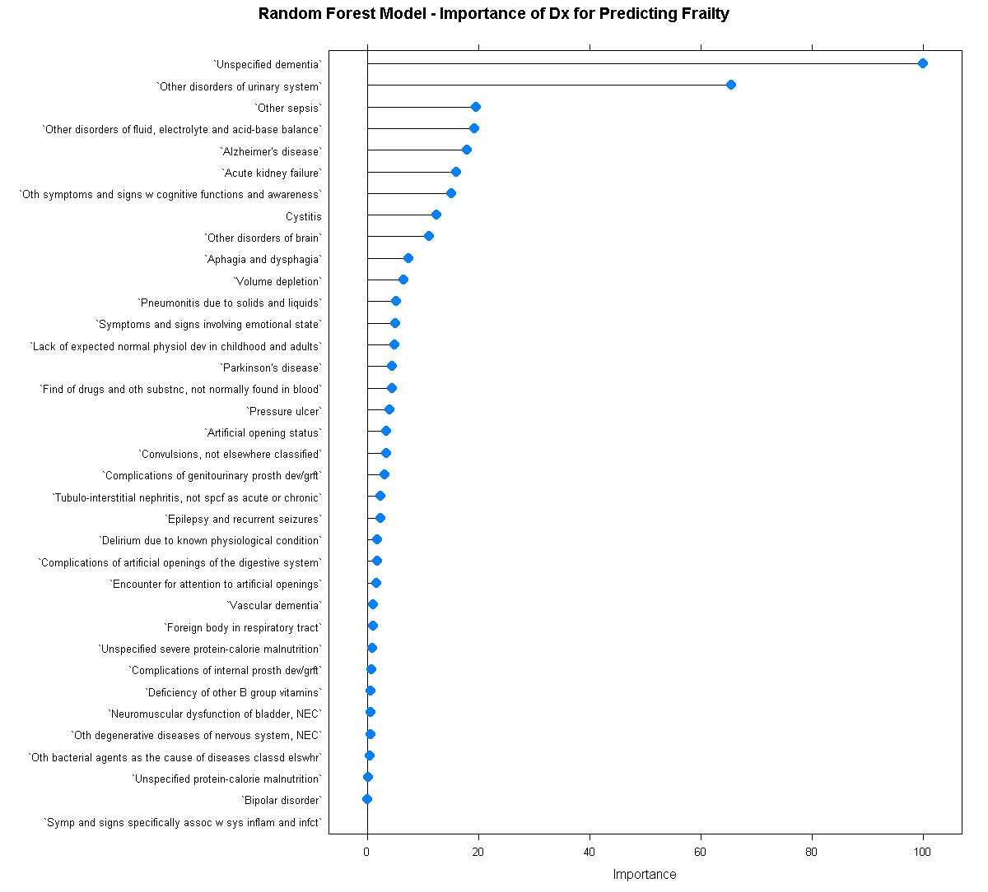
Use inverse of random forest variable importance to calculate a modified HFRS for each patient
The rank of each feature provides a weighting as to how well each ICD category correlates with advanced illness

Slide 17
Results: Association between developed score and outcomes (on an out of sample validation data set)
Score-Outcome | OR | OR 95% CI | OR Adjusted | OR Adjusted 95% CI | p-value
M-HFRS - Readmission within 30 days | 1.06 | 0.95 - 1.19 | 1.03 | 0.92 - 1.16 | 0.30
LACE >= 10 - Readmission within 30 days | 2.40 | 2.18 - 2.64 |  |  | <.01
M-HFRS - Seen by Pall Care | 2.46 | 2.22 - 2.73 | 2.08 | 1.87 - 2.31 | <.01
LACE >= 10 - Seen by Pall Care | 1.26 | 1.13 - 1.40 |  |  | <.01

Slide 18
Summary:
LACE >= 10 is more strongly associated with the risk of readmission within 30 days.
The adjusted M-HFRS is more strongly associated with being seen by the palliative care service.

Slide 19
Future Plans
Plan to pilot at one of our community hospitals
Calculate the score every morning for admitted patients
This will involve use of R services in SQL Server
Display score alongside LACE score in a Tableau dashboard
Periodic re-training of model to account for model drift

Slide 20
Thank You

Slide 21
Reference Slides

Slide 22
Data Table Structure (R Package: dplyr)

Slide 23
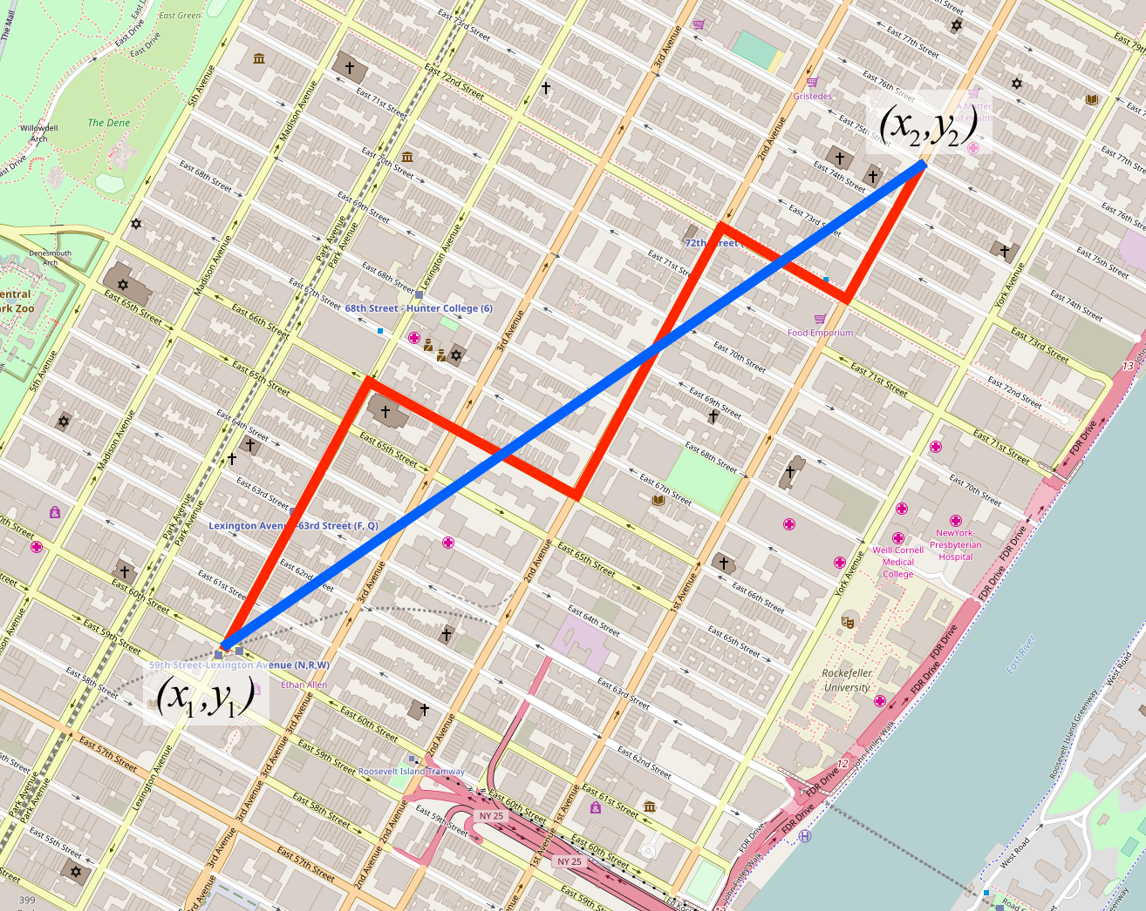
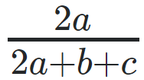
Phase 1: Clustering Details
Need to compute pairwise distances between all observations in data set
Used Gower’s Method to handle distance computation for mixed data types (continuous and binary)
Continuous Data: Range Normalized Manhattan Distance
Binary Data: Dice Coefficient
a - number of 1s for both observations
b - number of 1s for observation A and 0s for observation B
c - number of 0s for observation A and 1s for observation B
d - number of 0s for both observations
Red = Manhattan Distance
Blue = Euclidean Distance

Slide 24
Phase 1: Clustering Details
Need a way to compute distance between sets of observations as a function of the pairwise distances between observations
We used Ward’s Method (vs. Complete, Average) (R Package: stats::hclust())
Looks to minimize the total within-cluster variance when merging clusters

Slide 25
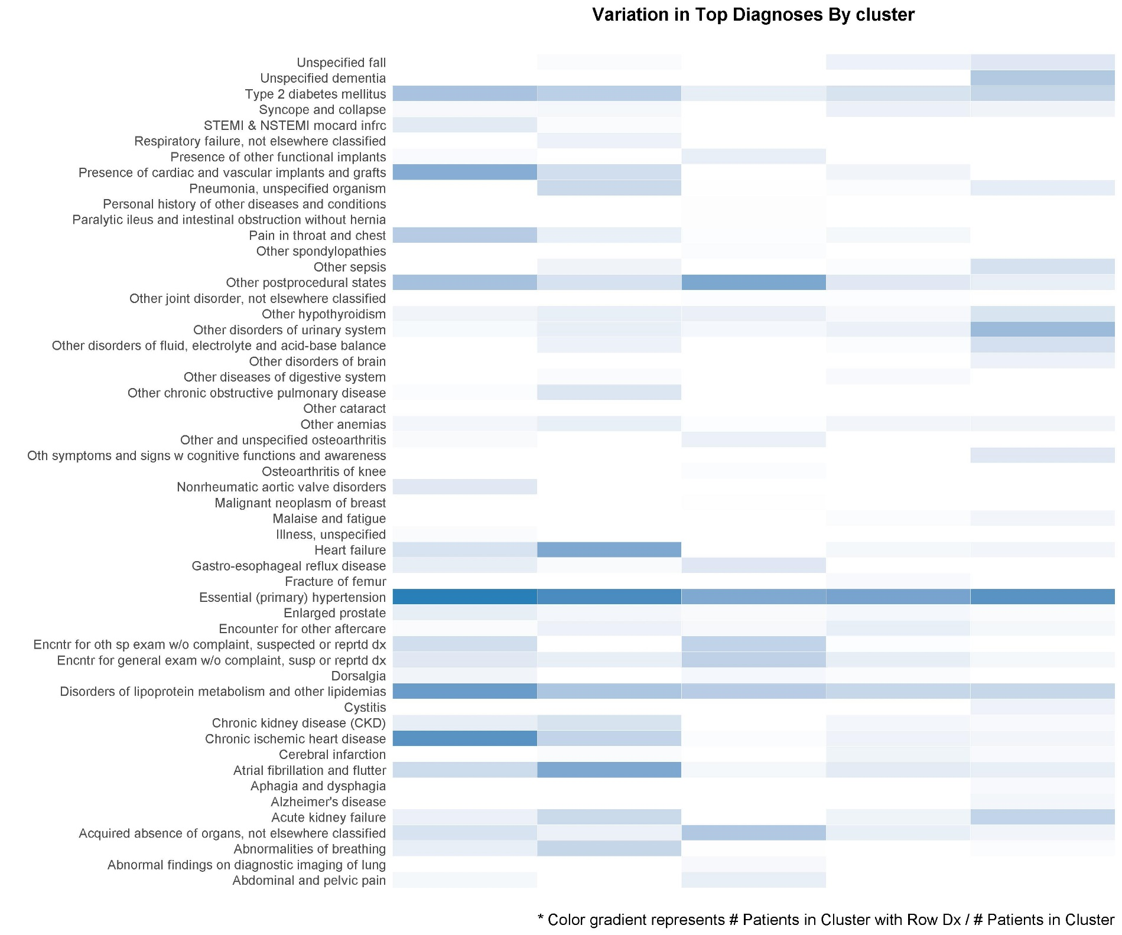
Phase 1: Clustering

Slide 26
Phase 3: Association with Outcomes – Original Data Set
Score-Outcome | OR | OR 95% CI | OR Adjusted | OR Adjusted 95% CI | p-value
M-HFRS - Long LOS | 1.44 | 1.29 - 1.61 | 1.39 | 1.24 - 1.56 | < .01
LACE >= 10 - Long LOS | 1.44 | 1.37 - 1.52 |  |  | < .01
M-HFRS - Readmission within 30 days | 1.51 | 1.35 - 1.68 | 1.49 | 1.33 - 1.66 | < .01
LACE >= 10 - Readmission within 30 days | 2.38 | 2.27 - 2.50 |  |  | < .01
M-HFRS - Seen by Palliative Care | 2.03 | 1.80 - 2.28 | 1.78 | 1.57 - 2.00 | < .01
LACE >= 10 - Seen by Palliative Care | 1.16 | 1.09 - 1.23 |  |  | < .01

